Slide 1
Network Games Programming
Mario.Soflano@gcu.ac.uk
Room M611A
Discord: MarioSoflano#3996

Slide 2
Network Topology
A network topology determines how the computers in a network are connected to each other. In the context of a game, the topology determines how the computers participating in the game will be organized in order to ensure all players can see an up-to-date version of the game state.

Slide 3








Client-Server
Centralised Messaging
Efficient solution in terms of network traffic
Longer delays because
each message is relayed through the server
Clients may have to poll the server for messages
System can survive failure of individual clients but the server is a single point of failure
Inadequacies of network connections (i.e. Internet connections) will give some clients an advantage
Server
Client 4

Slide 4
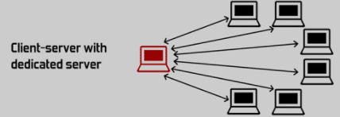
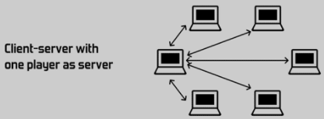
Client-Server
Dedicated: only run the game state and communicate with all of the clients
Listen Server: the server is also an active participant in the game itself as a “host”.

Slide 5
Client – Server (Listen Server)
Disadvantages
Network Performance is impacted by having to communicate with remote players over the residential internet connection of the host player.
Network Performance may also be reduced because the machine running the server is also generating an output image.
Listen servers grant the host player a large latency advantage over other players.
The hosting client has access to all the world's information, making it easier to cheat for that player.
The server will cease to exist when host player leaves the game.
Advantages
Essentially free
Do not require any special infrastructure or forward planning to set up, which makes them common at LAN parties where latency and bandwidth issues are not a concern.

Slide 6





Peer-to-peer
Many network connections needed
N clients, leads to N*(N-1) individual connections
Each client ‘broadcasts’ its status to all other clients
Networks provide for this, so message transmission can be quick
Each client needs to keep track of all others
No ‘shared’ data, so all clients need to maintain state of all others
ClientA ClientB
ClientE
ClientC
ClientD
14

Slide 7
Deterministic Peer-to-peer
Every client simulates everything in the exact same way but the only thing that needs to be sent over the network is each player's actions
The game runs as lots of really short turns: every step the game collects the commands from all players over the network and then simulates the next step.
Deterministic peer to peer has the enormous benefit that you hardly need to send anything apart from the player action
A downside to this model is that it usually adds quite a lot of lag to controls, since actions cannot be executed until all players know about them. Such input lag can be hidden by playing sounds and visual effects immediately when the user clicks. This way the player won't notice that his units don't react immediately. Note that deterministic lockstep can also be combined with a client/server connection model where the data always flows through the server instead of directly between all players.

Slide 8
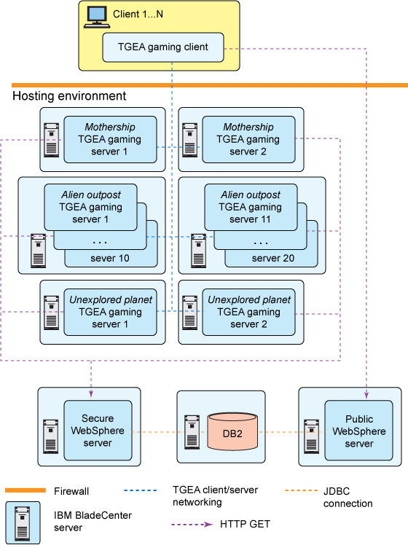
IBM MMO Architecture
Notes:
https://www.ibm.com/developerworks/library/ar-powerup1/

Slide 9
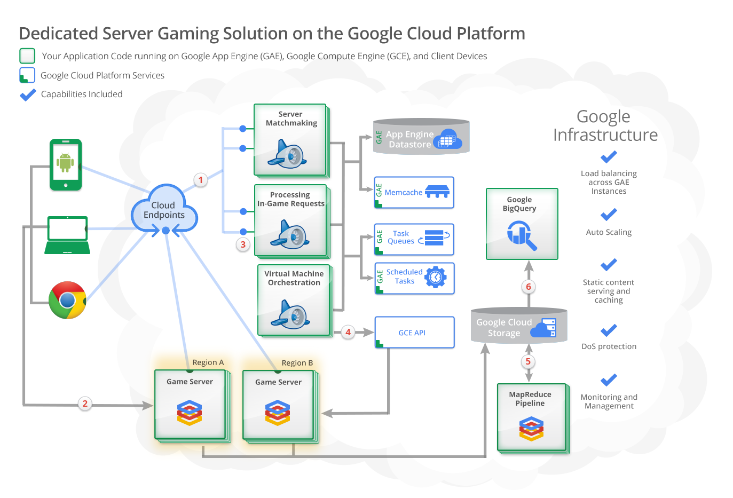
Cloud Server for Game?
Notes:
https://cloud.google.com/solutions/gaming/dedicated-server-gaming-solution/

Slide 10
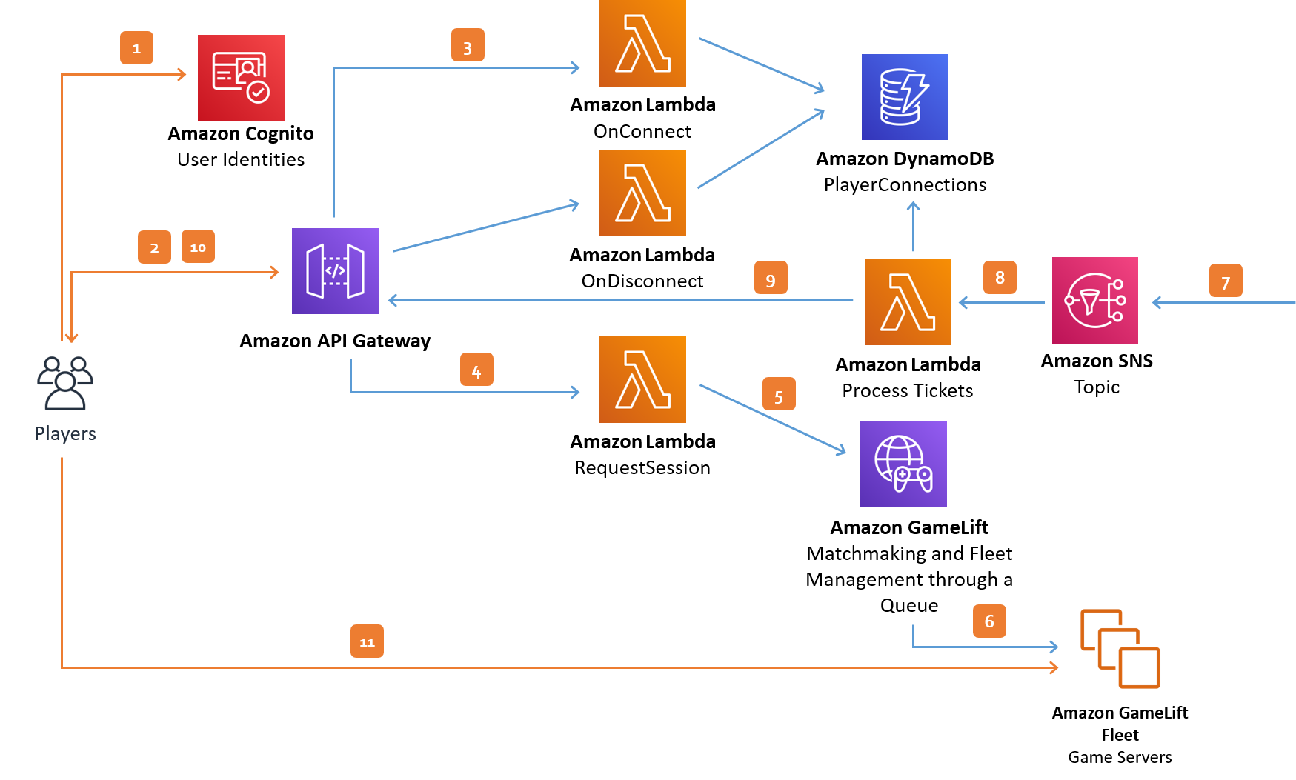
Notes:
Amazon GameLift

Slide 11
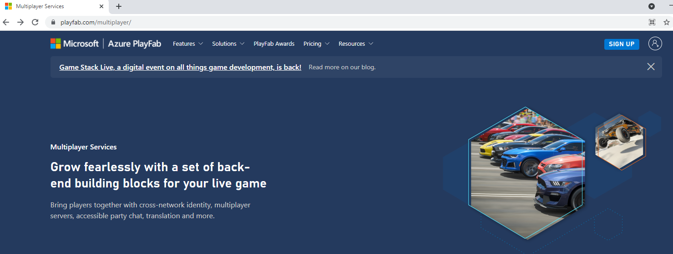
Notes:
- https://playfab.com/multiplayer/
-

Slide 12
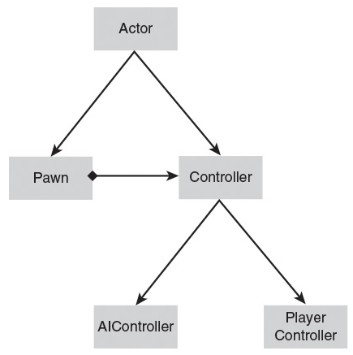
Developing Network Games - Unreal
Highlights of the Unreal class hierarchy

Slide 13
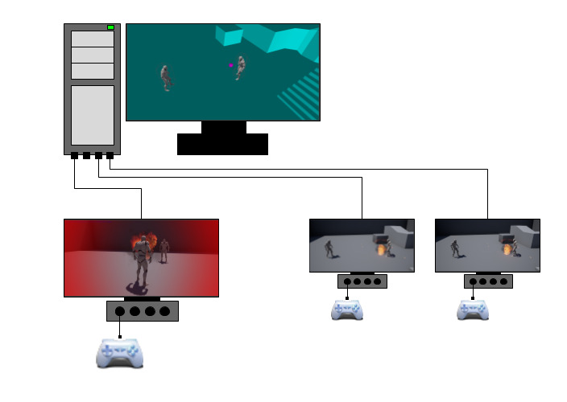
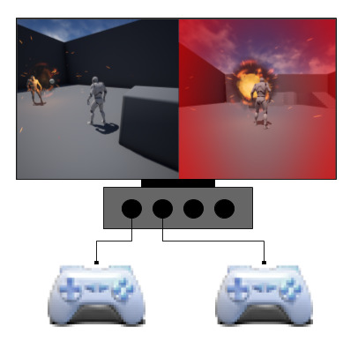
Network Mode - Unreal
Local Gameplay | Network Gameplay

Slide 14
Replication – Unreal
Replication Feature | Description
Creation and Destruction | When an authoritative version of a replicated Actor is spawned on a server, it automatically generates remote proxies of itself on all connected clients. It will then replicate information to those remote proxies. If you destroy an authoritative Actor, it will automatically destroy its remote proxies on all connected clients.
Movement Replication | If an authoritative Actor has Replicate Movement enabled, or bReplicateMovement is set to true in C++, it will automatically replicate its Location, Rotation, and Velocity.
Variable Replication | Any variables that are designated as being replicated will automatically replicate from the authoritative actor to its remote proxies whenever their values change.
Component Replication | Actor Components replicate as part of the Actor that owns them. Any variables within the Component that are designated as being replicated will replicate, and any RPCs called within the component will behave consistently with RPCs called in the Actor class.
Remote Procedure Calls (RPCs) | RPCs are special functions that are transmitted to specific machines in a network game. No matter what machine an RPC is initially called on, its implementation will run only on the machine it is intended for. These may be designated as Server (only runs on the server), Client (only runs on the Actor's owning client), or NetMulticast (runs on every machine connected to the session, including the server).

Slide 15
Replication - Unreal
Several common features of Actors, Pawns, and Characters do not replicate:
Skeletal Mesh and Static Mesh Components
Materials
Animation Blueprints
Particle Systems
Sound Emitters
Physics Objects

Slide 16
Network Role and Authority - Unreal
Network Role | Description
None | The Actor has no role in a network game and does not replicate.
Authority | The Actor is authoritative and replicates its information to remote proxies of it on other machines.
Simulated Proxy | The Actor is a remote proxy that is controlled entirely by an authoritative Actor on another machine. Most Actors in a network game, like pickups, projectiles, or interactive objects, will appear as Simulated Proxies on remote clients.
Autonomous Proxy | The Actor is a remote proxy that is capable of performing some functions locally, but receives corrections from an authoritative Actor. Autonomous Proxy is usually reserved for Actors under the direct control of a player, like Pawns.

Slide 17
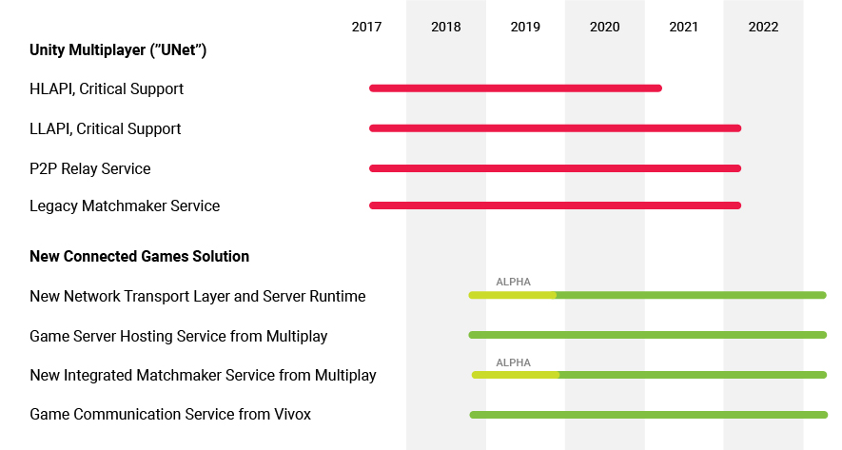
Unity
Unity 5.1 introduced a new networking library called UNET with three different APIs:
- a higher-level API that can handle most networked game usage cases
- lower-level transport API that can be used for custom communication over the Internet, as required.
Unity 2020 introduced
- mid-level API

Slide 18
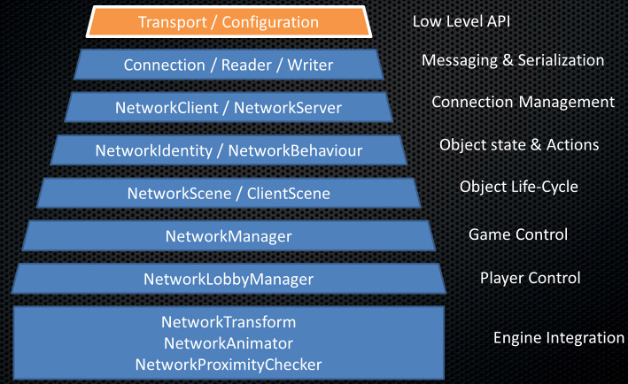

Slide 19
Unity - HLAPI
The HLAPI is a new set of networking commands built into Unity, within a new namespace: UnityEngine.Networking. It is focused on ease of use and iterative development and provides services useful for multiplayer games, such as:
Message handlers
General purpose high performance serialization
Distributed object management
State synchronization
Network classes: Server, Client, Connection, etc

Slide 20
Unity - LLAPI
The Transport Layer supports base services for network communication. These base services include:
Establishing connections
Communicating using a variety of “quality of services”
Flow control
Base statistics
Additional services, such as communication via relay server or local discovery
Specifically:
Creating UnityWebRequests
Creating UploadHandlers
Creating DownloadHandlers
The Transport Layer can use two protocols: UDP for generic communications, and WebSockets for WebGL

Slide 21
Unity - Netcode
Unity Netcode is a package that includes mid-level networking library built for the Unity game engine to abstract networking (previously called MLAPI)
This allows developers to focus on the game rather than low level protocols and networking frameworks.

Slide 22
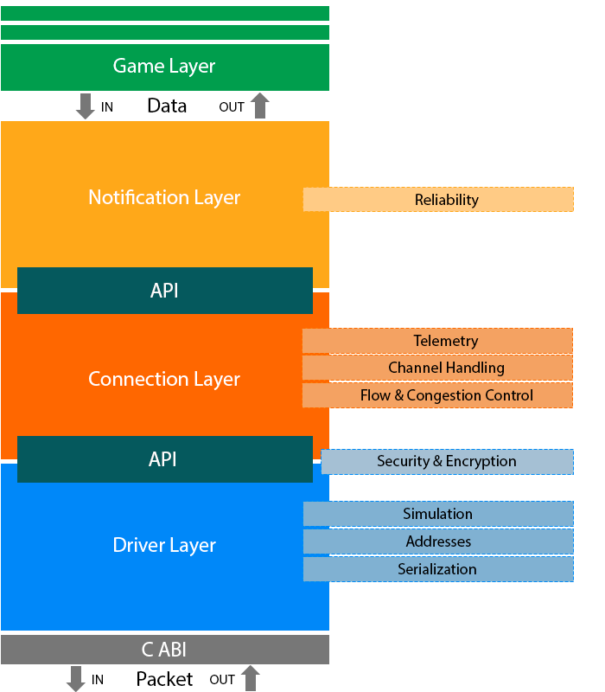
Unity – MLAPI Transport
Unity Transport provides a new wrapper for Unity MLAPI through com.unity.transport

Slide 23
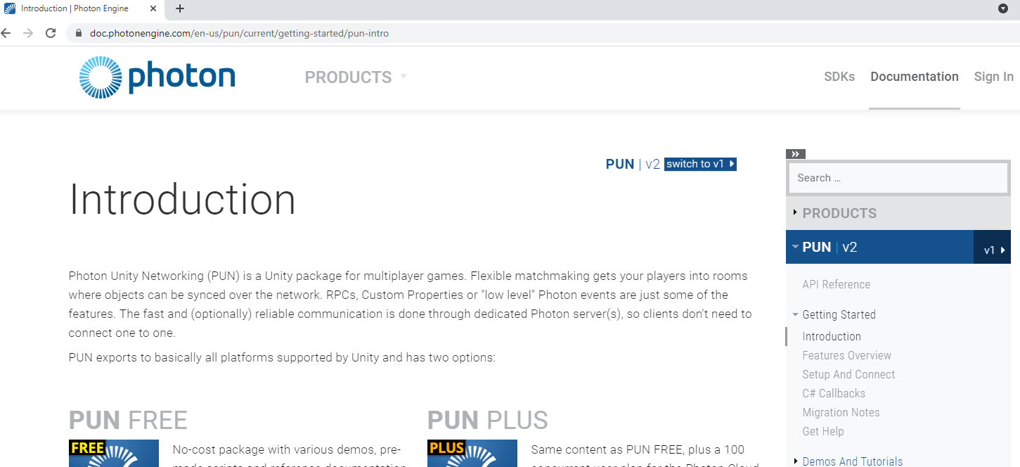
Unity – Photon

Slide 24
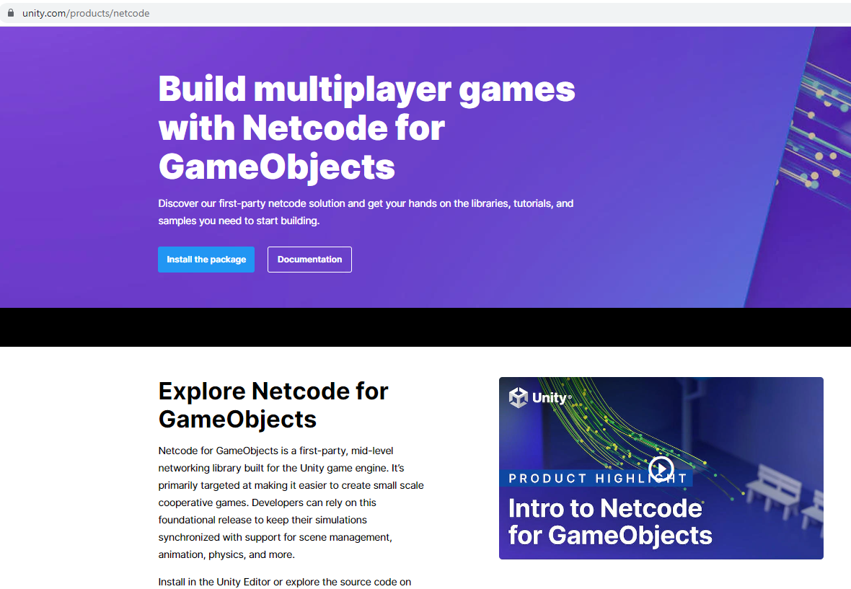
Unity – Netcode

Slide 25
Web Technology

Slide 26
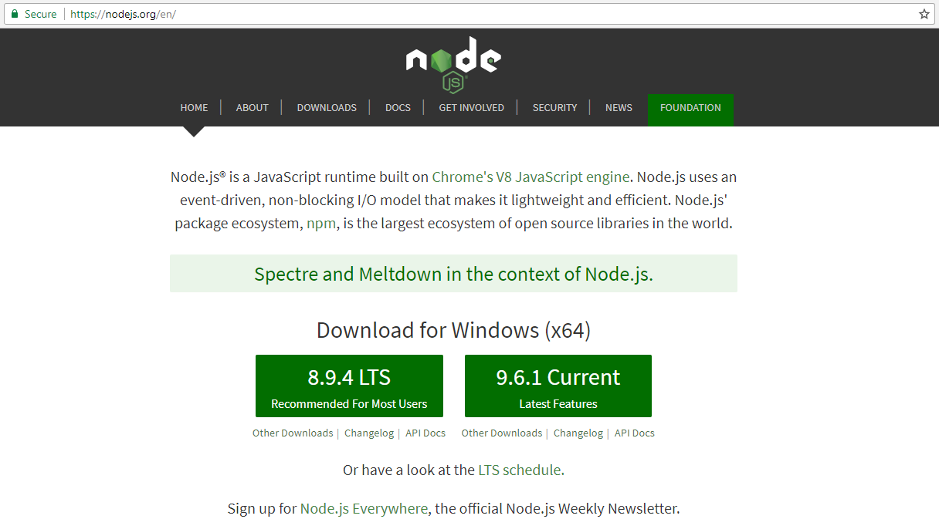
NodeJS

Slide 27
NodeJS vs XAMPP
XAMPP is a distribution consisting of Apache, MySQL and PHP. So you are using Apache as your web server.
Node.js is a Javascript framework. You could build you own web server with Node.js
Node.js uses Javascript on the server while XAMPP / Apache uses PHP
Notes:
https://stackoverflow.com/questions/32990253/whats-the-difference-with-node-js-and-xampp

Slide 28
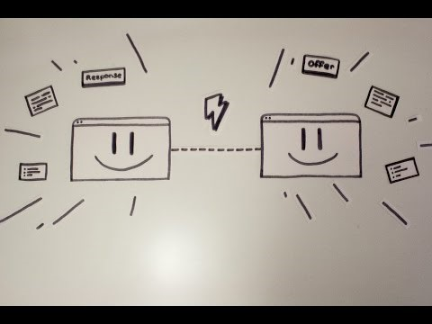
WebRTC

Slide 29
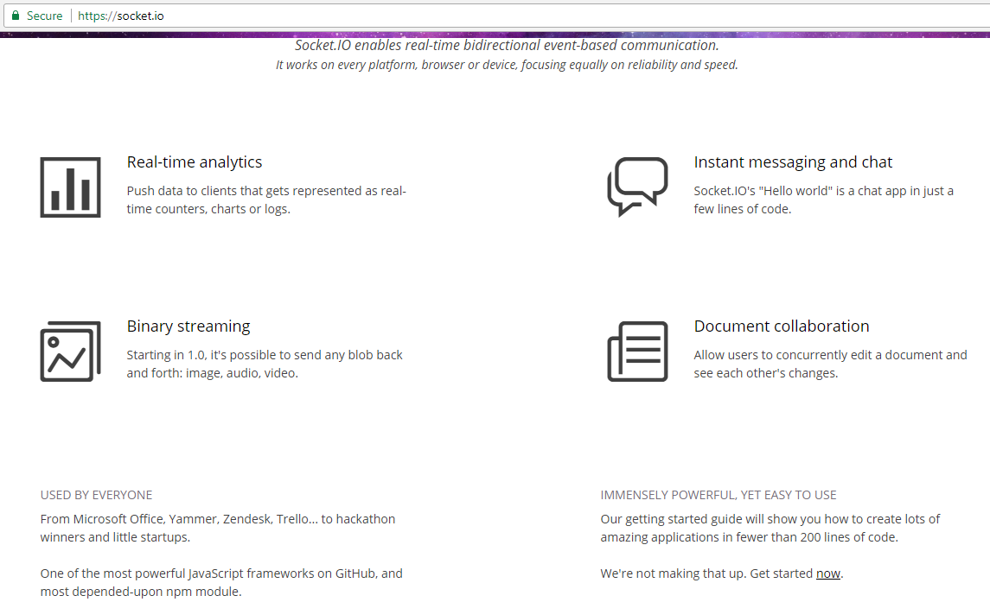
Socket.io

Slide 30
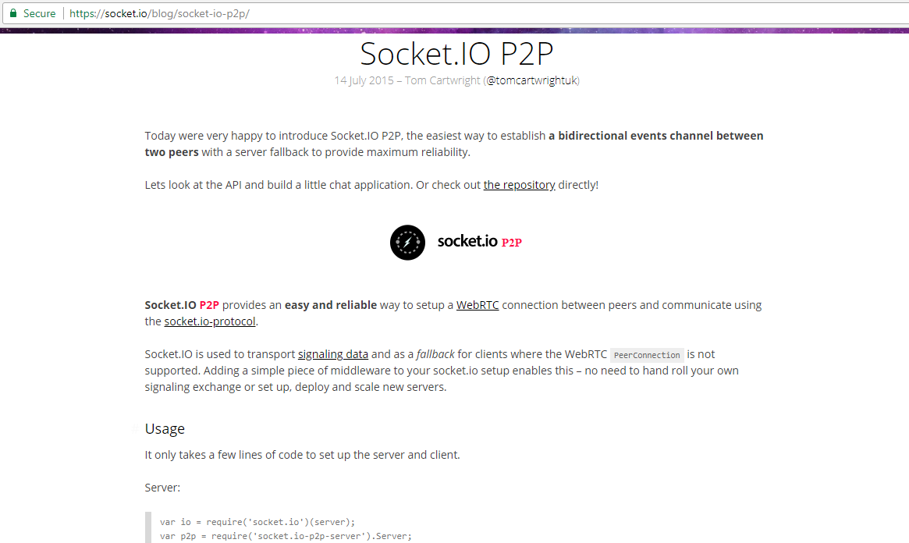
Socket.io

Slide 31
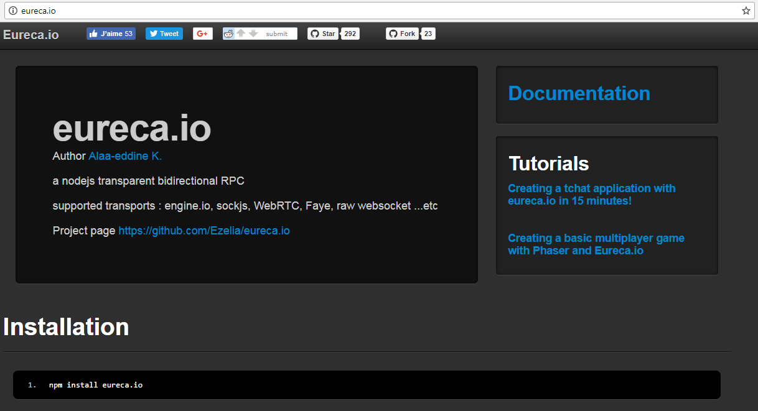
Eureca.io
Notes:
eureca (Easy Unobstructive REmote CAll) is a node.js bidirectional RPC library.
It allow you to call server side functions from the browser (or from nodejs client) and vice-versa.
Eureca.io can use many transport layers (engine.io, socket.io, raw websockets, Faye and browserchannel) thanks to Primus.io.
Next version of Eureca.io will also support WebRTC based on node-webrtc.

Slide 32
Unity References
https://unity.com/products/netcode
https://docs-multiplayer.unity3d.com/netcode/current/about/index.html
https://www.youtube.com/watch?v=3yuBOB3VrCk&t=2399s

Slide 33
Unity References
https://docs-multiplayer.unity3d.com/?_ga=2.194741293.1083482244.1631699016-267985189.1628853210
https://docs-multiplayer.unity3d.com/docs/learn/rpcvnetvar/index.html
https://www.youtube.com/watch?v=Y3dKKJwQ8hU mlapi new https://gamedevacademy.org/unity-mlapi-tutorial/ (Youtube Dapper Dino)
https://docs.unity3d.com/2021.1/Documentation/Manual/UNetUsingHLAPI.html
https://docs-multiplayer.unity3d.com/docs/getting-started/about-mlapi
https://www.youtube.com/watch?v=77vYKsXC4IE – multiplayer game architecture in Unity
https://docs.unity3d.com/Manual/UNetUsingTransport.html

Slide 34
Unreal References
https://docs.unrealengine.com/4.27/en-US/InteractiveExperiences/Networking/
https://www.unrealengine.com/en-US/tech-blog/getting-started-with-unreal-multiplayer-in-cpp
https://www.gamedev.tv/p/unrealmultiplayer/?product_id=1500305&coupon_code=JOINUS
https://docs.unrealengine.com/4.27/en-US/InteractiveExperiences/Networking/QuickStart/
https://www.unrealengine.com/en-US/bing-search?x=0&y=0&filter=Documentation&keyword=multiplayer
https://github.com/minimpoun/UE4-Multiplayer-Example
https://edirlei.com/aulas/dp-2019/DP_Lecture_06_Matchmaking_Server_Unreal_Engine_2019.pdf

Slide 35
Other
https://medium.com/swlh/building-a-realtime-multiplayer-browser-game-in-less-than-a-day-part-2-4-f1f109761cf3 - Build multiplayer with Phaser for Web

